Slide 1
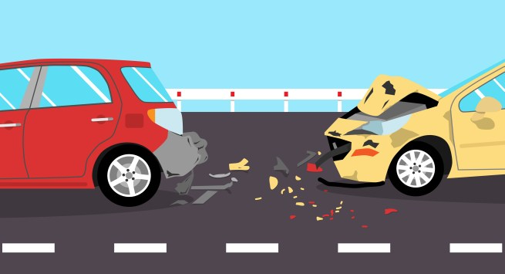
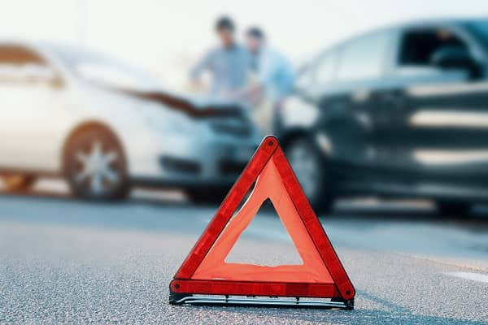
Car Accidents
Lior turgeman 304941412
Dan avERIN 204358394

Slide 2
Project Overview and Research Question
Is there a connection between the amount of car accidents to the weather conditions occurred at the time of the accident?
Is there a connection between the weather and the type of accidents happened (In intersection, what type of Objects were harmful in the collision…)
Is it possible To predict which accidents will happened according to the road type?
Is there a connection between car accidents and the time/day/night conditions?
Are there states in which more car accidents are likely to occur?

Slide 3
מקורות מידע API הרכשה אם עשינו+ לינקים\
API & Sources
We chose to use information from NHTSA(National Highway Traffic Safety Administration) - agency of the U.S. federal government, part of the Department of Transportation.
https://crashviewer.nhtsa.dot.gov/CrashAPI
We used the API to retrieve CSV data files from years 2010 up to 2019.

Slide 4
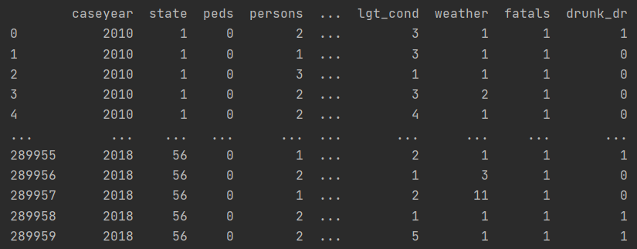
Data Handling and Cleaning
- At out project we used data from the years 2010 up to 2019.
- Each year had close to 35,000 records, eventually we got around 290,000 records as result of 10 years of car accidents data from the USA.
- We emitted irrelevant data from the original csv files, combined all data to one file which will be used to research the question we presented.

Slide 5
פירוט על שימוש בAPI

Slide 6
פירוט על הרכשה

Slide 7
EDA – הסבר על סינון הנתונים כמה נתונים לא רלוונטים שניקנו מהDATA כמה שקופיות

Slide 8
מסקנות לאחר ניקוי המידע הוצאה של גרפים – מסקנות

Slide 9
למידת מכונה מסקנות ואיך לבצע

Slide 10
TEXT

Slide 11
TEXT

Slide 12
TEXT

Slide 13
TEXT

Slide 14
TEXT

Slide 15
TEXT

Slide 16
TEXT

Slide 17
TEXT

Slide 18
TEXT

